Slide 1
ARDUINO interface with DHT11
Aim : To study interface of Arudino with Temperature and Humidity Sensor

Slide 2
Introduction to Arduino
Arduino is a open source platform use for building Electronics projects.
Arduino consists of both physical programmable circuit board or microcontroller and a software ,IDE that runs on a computer.
It is used to write and upload computer code to the physical board
The boards are equipped with set of Analog I/O,digital I/O pin,USB connection which is used for loading programs from computers,power jack ,reset button etc.
ATMEG328 microcontroller is used in Arduino

Slide 3
Code Structuring in Arduino IDE
It consists of only two functions SETUP() and LOOP()
Setup() function is used to initialize variables of input and output pin modes and other libraries needed in the sketch
After setup has been called function loop() is executed repeatedly in main program
It controls the board until the board is powered off or reset

Slide 4
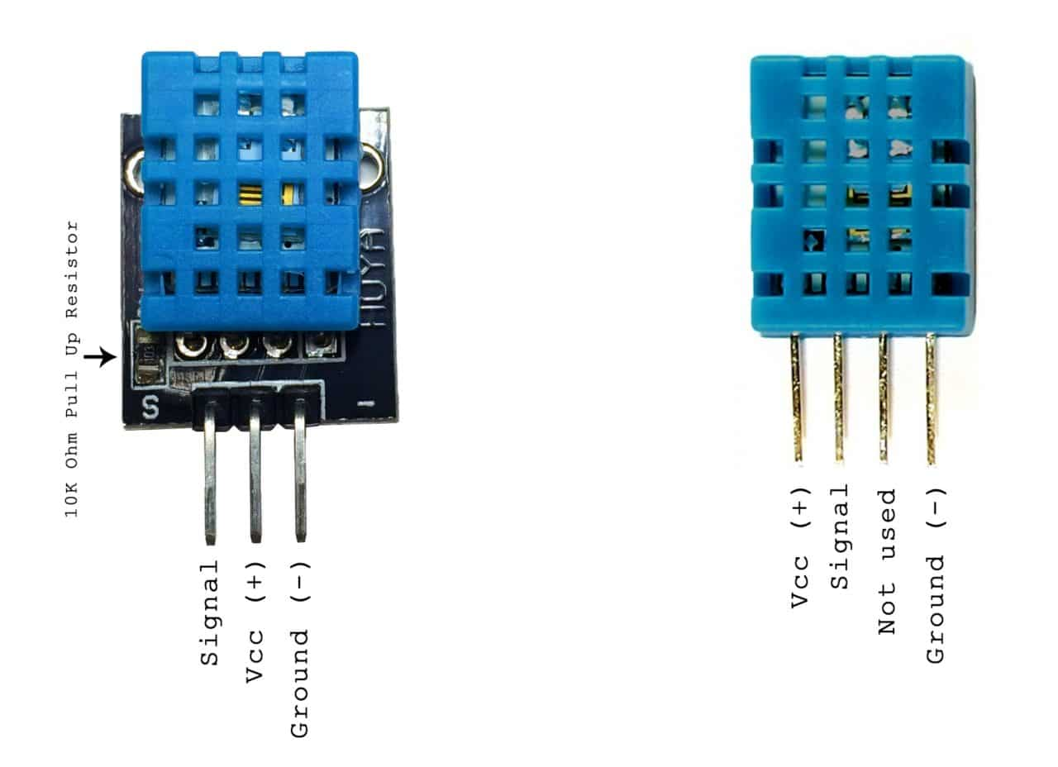
DHT11 Sensor
DHT 11 is a Humidity and Temperature Sensor
DHT11 is digital sensor sending the data of temperature and humidity in 40 bytes or 5 bytes
Features of DTH11
DHT11 Specifications:
Operating Voltage: 3.5V to 5.5V.
Operating current: 0.3mA (measuring) 60uA (standby)
Output: Serial data.
Temperature Range: 0°C to 50°C.
Humidity Range: 20% to 90%
Resolution: Temperature and Humidity both are 16-bit.
Accuracy: ±1°C and ±1%
05 bytes Serial Monitor and Serial Plotter

Slide 5
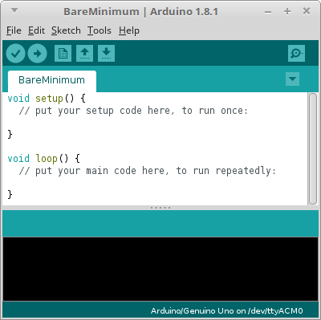
Setup() Function
PURPOSE − The setup() function is called when a sketch starts. Use it to initialize the variables, pin modes,
start using libraries, etc. The setup function will only run once, after each power up or reset of the Arduino board.
INPUT − -
OUTPUT − -
RETURN −

Slide 6
Loop() Function
After creating a setup() function, which initializes and sets the initial values, the loop() function does precisely what its name suggests, and loops consecutively, allowing your program to change and respond. Use it to actively control the Arduino board.
INPUT − -
OUTPUT − -
RETURN − -

Slide 7
Program to Interface DTH11 with Arduino
# include<simple DHT.h>
int pin DHT11=Ao; declaration of Ao analog pin a int type
Simple DHT11 dht11;Object created at instance class DHT11 is created
void setup()
{
PinMode(LED_BUILTIN,OUTPUT);initialize input pin for use of input LED
Serial.println(“DHT11 Humidity and Temperature sensor\n\n”);Initializes serial communication
delay(1000);provide 1000ms delay inbuilt function
}
contd......

Slide 8
Program to Interface DHT11 with Arduino
Void Loop()
{
byte temperature = 0; initialize temperature to 0
byte humidity = 0;initialize humidity to 0
dht11.read(pin DHT11 ,&temperature, &humidity,NULL);read values of temperature and humidity from dht11 sensor
Serial.print(“Temperature and Humidity :”)
Serial.print(“ *C&”);
Serial.Print((int)humidity);
Serial.Println(“% H”);
contd......

Slide 9
Program to Interface DHT11 with Arduino
delay(2000);
if ((int)temperature >=27)) // check whether greater than room temperature
{
digitalwrite(LED-BUILTIN,HIGH);Writes an digital value to the pin 13 where builtin LED is connected
Serial.print(“LED.ON”);
}else
{
digitalWrite(LED_BUILTIN,LOW);
Serial.print(“LED OFF”);
}

Slide 10
UPLOADING and Compiling the PROGRAM
To install Arduino IDE
Go to website www.Arduino.cc click on download links
Download Arduino 1.6.9 version latest on Windows Non admin install
recommended
On Arduino sketch window click on Tools on Menu bar and even goto help on Menu bar to get all library Functions available with I/O Analog/Digital Read/Write functions
Save your program with sketch____ then upload program in ATMEGA328 using Right hand arrow symbol on menu bnd Compile to verify by clicking on Tick mark on menu bar

Slide 11
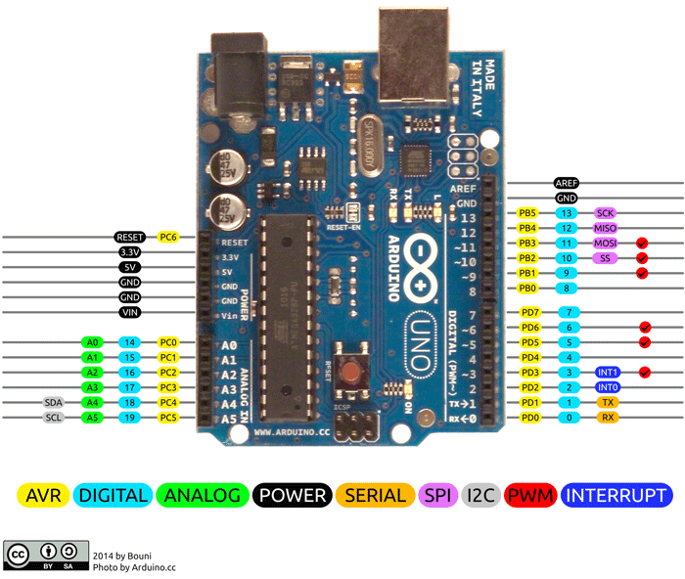
ARDUINO UNO BOARD

